Slide 1
Lecture 2
Fundamentals of Programming

Slide 2
Learning Objectives
In this chapter, you will learn:
Understand the program development cycle and why planning is important.
Learn how to design a program using pseudocode and flowcharts.
Use the print() function to display output in Python.
Understand the importance of comments (#) in Python.
Convert pseudocode into Python through a salary calculation exercise.

Slide 3
Designing a Program (1 of 3)
Programs must be designed before they are written
Program development cycle:
Design the program
Write the code
Correct syntax errors
Test the program
Correct logic errors

Slide 4
Designing a Program (2 of 3)
Design is the most important part of the program development cycle
Understand the task that the program is to perform
Work with customer to get a sense what the program is supposed to do
Ask questions about program details
Create one or more software requirements

Slide 5
Designing a Program (3 of 3)
Design Determine the steps that must be taken to perform the task
Break down required task into a series of steps
Create an algorithm, listing logical steps that must be taken
Algorithm: set of well-defined logical steps that must be taken to perform a task

Slide 6
Algorithm
Algorithm to add 2 numbers and print their sum:
START
Input two numbers, Number1 and
Number2 respectively.
Add the two numbers and store the result in
the variable Sum.
Print the value of Sum.
END

Slide 7
Pseudocode
Informal language that has no syntax rule
Not meant to be compiled or executed
Used to create model program
No need to worry about syntax errors, can focus on program’s design
Can be translated directly into actual code in any programming language

Slide 8
Flowcharts (1 of 2)
Flowcharts diagram that graphically depicts the steps in a program
Ovals are terminal symbols
Parallelograms are input and output symbols
Rectangles are processing symbols
Symbols are connected by arrows that represent the flow of the program

Slide 9
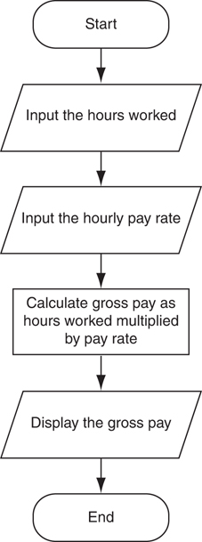
Flowcharts (2 of 2)
Start
Input
Input
Process
Output
End

Slide 10
Exercise 1: Algorithm for Adding Two Numbers
Step-by-Step Algorithm:
Start
Input Number1 and Number2
Calculate Sum = Number1 + Number2
Display Sum
End

Slide 11
Exercise 2 – Calculate BMI
Draw a flow chart to calculate BMI

Slide 12
The print() Function
Purpose: The print() function outputs text or variables to the console. It is essential for displaying results and debugging
Usage in Scripts: In Python scripts, print() is commonly used to show the results of operations or to inform the user of the program's progress.

Slide 13
The print() Function
Syntax: print() can accept multiple arguments separated by commas, which automatically inserts spaces between them.
Example:
print("Hello World.")
print(“The result is”, 10+5)
print("Welcome to Python programming!")

Slide 14
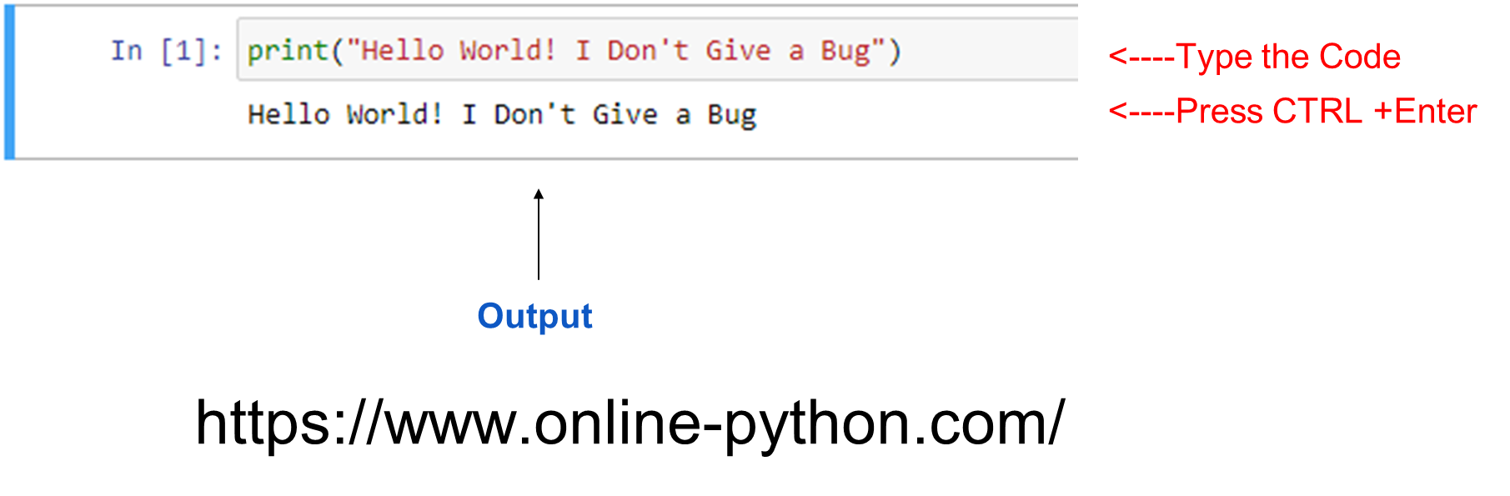
Writing a Basic Python Script

Slide 15
Comments in Python
Comments: notes of explanation within a program
Ignored by Python interpreter
Intended for a person reading the program’s code
Begin with a # character
End-line comment: appears at the end of a line of code
Typically explains the purpose of that line

Slide 16
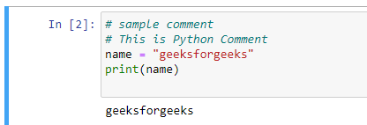
Comments - Example

Slide 17
Example: Pseudocode
Expected Steps:
START
Input name
Display "Hello, name"
END

Slide 18
Exercise: From Pseudocode to Python: Employee Salary Calculation
Task: Convert a simple pseudocode into Python. This exercise will help them understand how to go from logical steps to actual code.
Expected Steps:
START
Input employee_name
Input basic_salary
Calculate bonus = basic_salary * 0.10
Calculate total_salary = basic_salary + bonus
Display employee_name
Display total_salary
END

Slide 19
Keywords in Python
Keywords in Python are reserved words that can not be used as a variable name, function name, or any other identifier
if | def | return | continue
import | is | del | try
True | False | else | in
while | elif | lambda | with
except | None | yield | and
nonlocal | as | finally | not
assert | for | or | break
from | pass | class | global

Slide 20
Thank you

